Slide 1
ADOBE
Мovenko Konstantin, IS/b-21-2-f

Slide 2

Adobe
Adobe Inc. is a giant software company which created big amount of highly used programs, such as Photoshop, Illustrator, Acrobat and others.
It has historically specialized in software for the creation and publication of a wide range of content, including graphics, photography, illustration, animation, video and print.

Slide 3
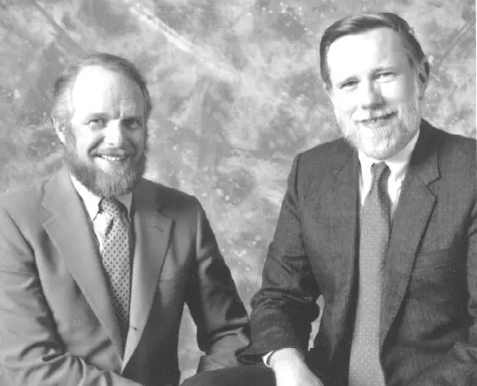
History
Around 1970 at the Xerox research center in Palo Alto, future Adobe founders John Warnock and Chuck Geschke met and shared their work researching graphic systems and printing. They decided to join forces and in 1982 created Adobe to innovate and improve ways to print text and images.
John Warnock (left) and Chuck Geschke (right)

Slide 4
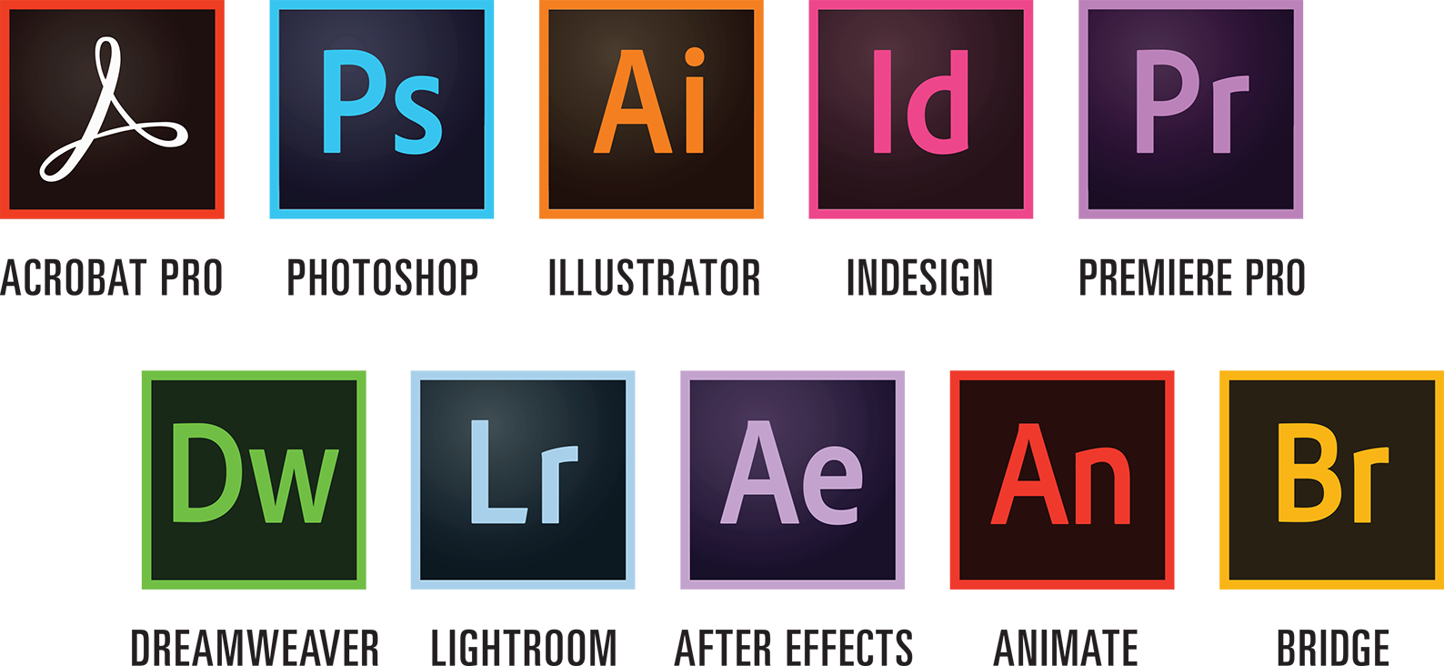
The Adobe’s first product was PostScript, a page description language used in the publishing. Later the company began growing up more and more with buying and developing different software projects.

Slide 5

In 1989, Adobe (after buying Thomas Noll’s project) introduced a graphics editing program called Photoshop, which became their flagship product and helped them dominate the market for a long time.
Later they released such programs, as Acrobat (and PDF file format), Premiere, After Effects and many others.

Slide 6
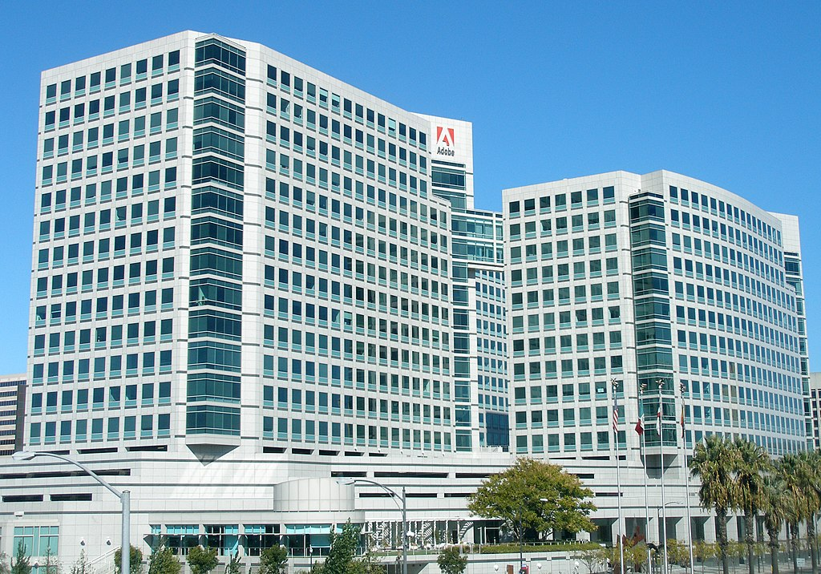
Headquarters
The main Adobe office (Adobe World Headquarters) is located in San Jose, California.
However, Adobe is very international company and has more than 26.000 employees worldwide. Adobe has major development operations in the US and in Noida and Bangalore in India.
Adobe office in San Jose, California

Slide 7

Criticism
Adobe Inc. has monopolistic place at a market of graphic and design software, and of course sometimes it abuses it for its goals.
A lot of conflicts around Adobe were tied with their anti-competitive practices. Adobe bought a lot of its competitors, and sometimes it leaded to the deaths of a whole projects, which gave a freedom for Adobe’s own products at the market.

Slide 8

Also, Adobe had some troubles with security of their software. Hackers exploited vulnerabilities in Adobe programs, such as Adobe Reader, to gain unauthorized access to computers.

Slide 9
THANK YOU FOR ATTENTION

